Slide 1
Lecture V: Distance Indicators in Cosmology
Physics 8803
February 6, 2019

Slide 2
General Concepts
Distances measurements may be:
“Absolute” – the distance measurement can be written in meters using previously known information (e.g. trigonometric parallax).
“Relative” – usually an empirical relation (e.g. period-luminosity relation of Cepheids), must be calibrated against an absolute method if we want it in meters (“anchor”).
The “distance ladder” – many versions, e.g.:
Trigonometric
parallax
Cepheid
variables
Type Ia
supernovae
(absolute but only feasible in Milky Way)
(relative; used out to ~30 Mpc)
(relative; used out to z>1)

Slide 3
Methods Covered Today
Cepheid variables
Galaxy scaling relations
Type Ia supernovae
Eclipsing binaries
Masers
Parallax
Gravitational wave sources
(I will cover strong lens systems later in the course.)
Red = relative; blue = absolute (anchors)

Slide 4
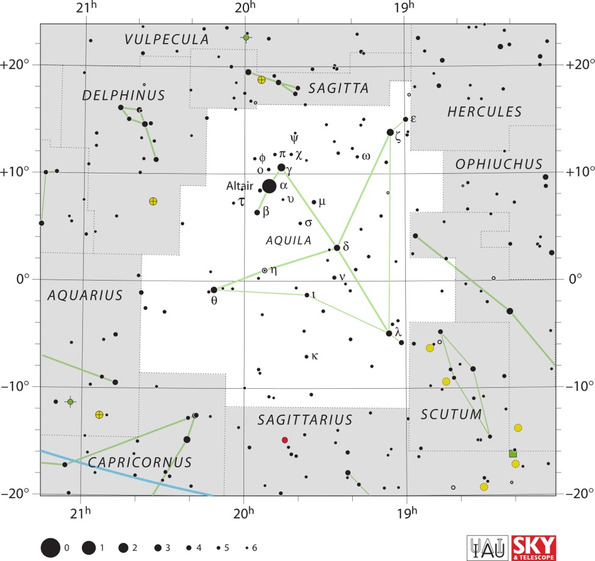
Cepheid Variables
η Aquilae
Variability discovered in 1784
Magnitude 3.5—4.3 (visible to your eye!!)
P = 7 days; D = 400 pc
Pulsating stars driven by κ-mechanism instability in He⁺/He²⁺ ionization boundary in the star
Chart credit:
Roger Sinnott & Rick Fienberg

Slide 5
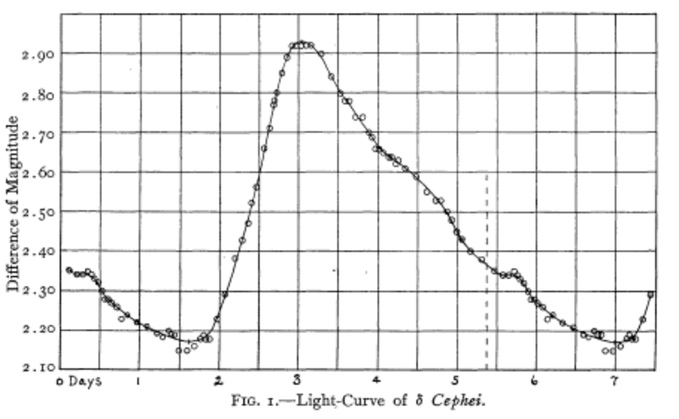
δ Cephei light curve
Stebbins et al. (1908)

Slide 6
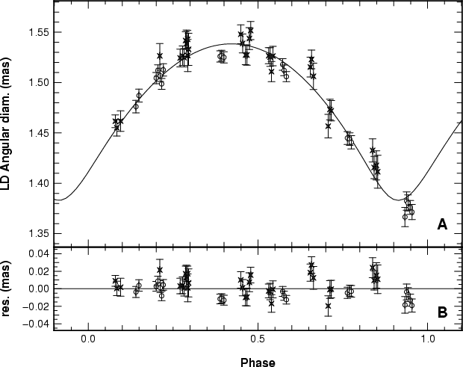
They Really Do Pulsate! δ Cephei measured via optical interferometry
Mérand et al. 2005

Slide 7
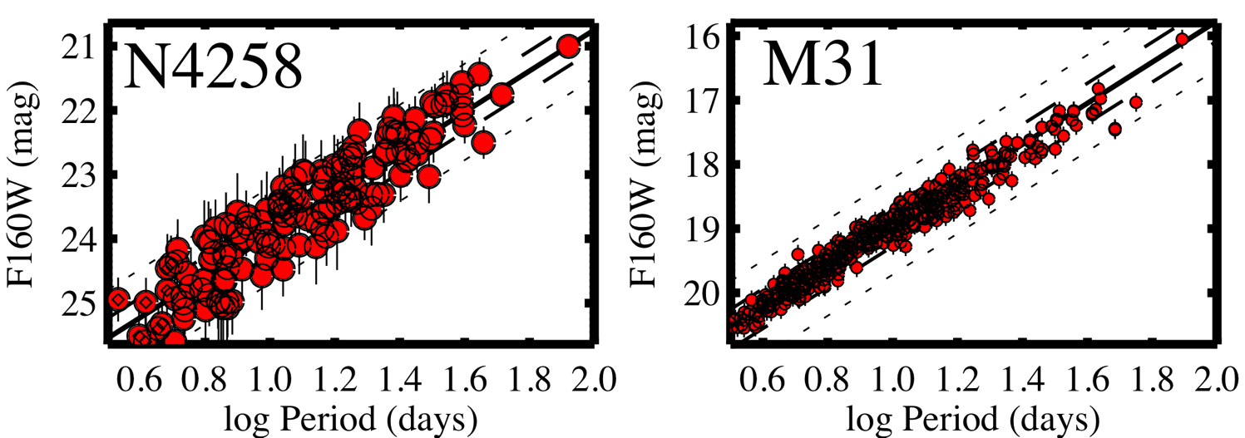
“Modern” Versions of Leavitt Diagram
A more distant galaxy
A nearby galaxy
F160W = Filter on Hubble Wide Field Camera 3; centered at ~ 1.6 µm
(Riess et al. 2016)

Slide 8
Cepheid Variables – Limitations
General:
Relative distance indicator; need anchor
Even with Hubble Space Telescope, range limited to nearby Universe (30—40 Mpc; not even in Hubble flow)
Observational:
Crowding/blending (gets worse at larger distances)
Extinction (dust)
Photometric calibration between bright/nearby and faint/distant Cepheids (both across instruments and within instruments, i.e. linearity)
The “nearest” Cepheids (with parallax) are often short P/low L vs. selection in distant galaxies for long P/high L
Physical:
Period-luminosity relation dependence on metallicity (note the Magellanic Clouds are low metallicity!)

Slide 9
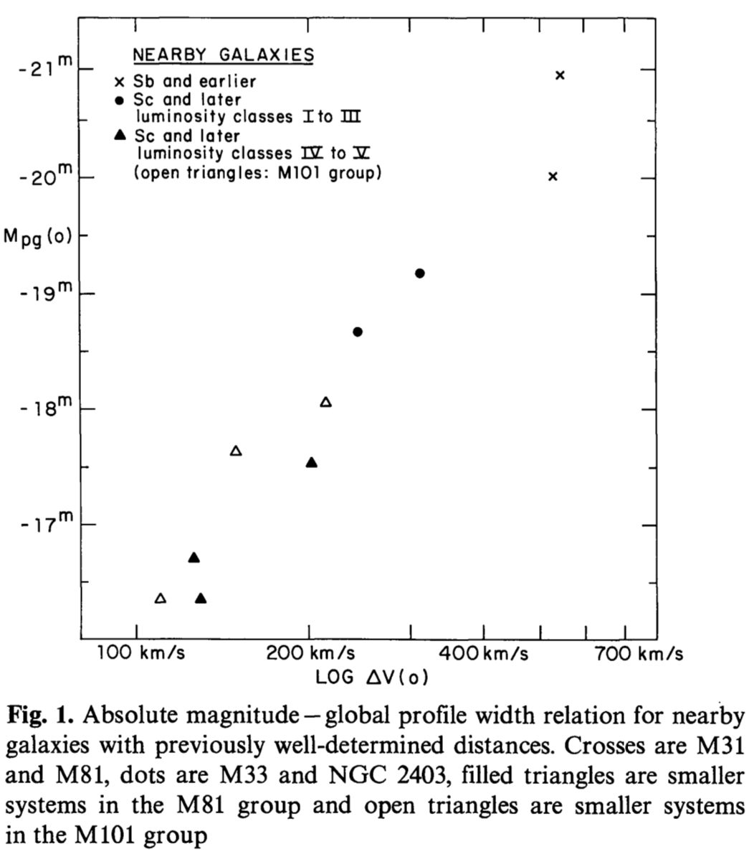
Galaxy Scaling Relations
Galaxies can be observed farther than Cepheids, but have a wide range of luminosities. Use empirical scaling relations.
e.g. Tully-Fisher relation for spiral galaxies (luminosity vs. rotation velocity measured in H I 21 cm)
Fundamental Plane for Ellipticals:
Radius vs. velocity dispersion & surface brightness
Tully & Fisher (1977)

Slide 10
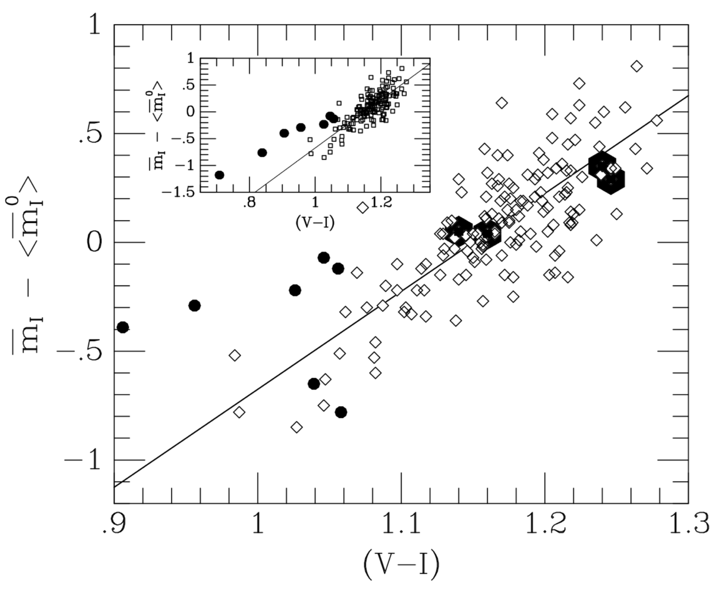
Surface Brightness Fluctuations
Useful for smooth components (bulges, ellipticals)
The (visible) light from galaxies comes from discrete stars with Poisson fluctuations.
At the same surface brightness, a more distant source will have more stars per pixel and smaller fluctuations (∆N/N).
Must calibrate effective “mean star” and dependence on color (indicating age).
Tonry et al. 1997

Slide 11
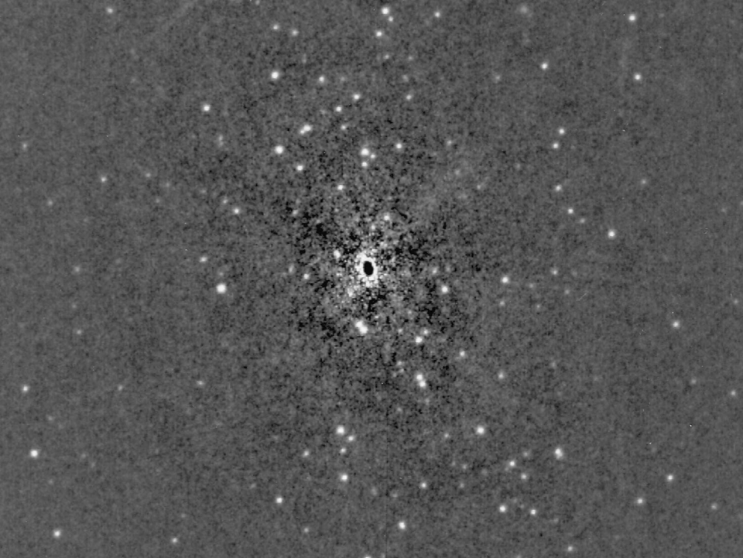
Smooth-model-subtracted image of BCG in Abell 3742
D = 60 Mpc
Lauer et al. (1998)

Slide 12

Expanding Photosphere Method (used for Type II Supernovae)
Luminosity L is related to radius:
But radius is related to (observable) velocity via Doppler shift of SN absorption lines – if spherically symmetric:
Infer T_{eff} from modeling of spectrum
(Related to Baade-Wesselink method for variable stars)
R
v
D
to Earth

Slide 13
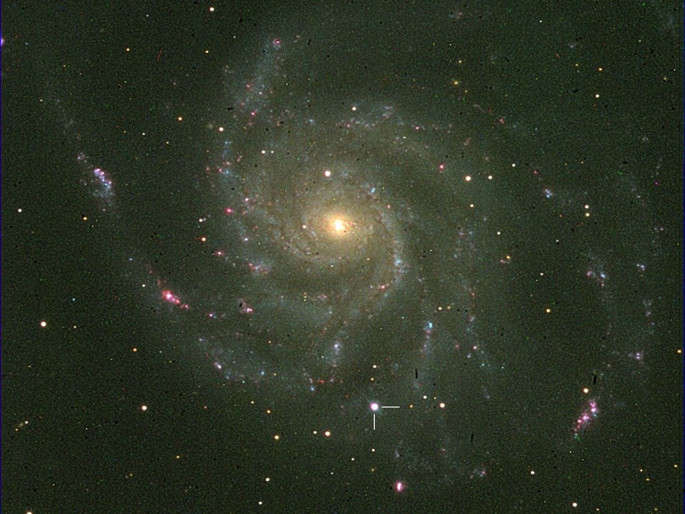
SN 2011fe in M101 – Nearest Type Ia SN in last four decades
(discovered by PTF, peak apparent magnitude 10)
Flynn Haase and Steve Peterson – Kitt Peak, Aug, 29, 2011

Slide 14
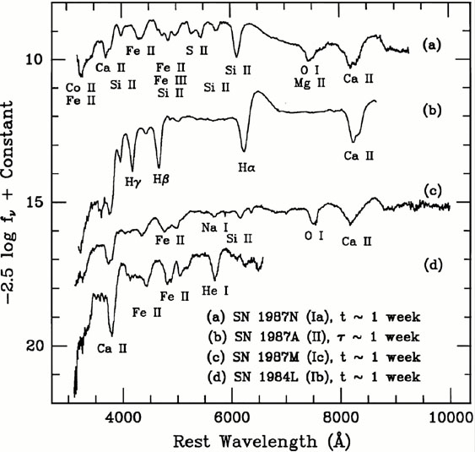
Supernova Spectra
Type Ia
No H or He
Prominent blueshifted Si II line, and other elements up to iron peak
Filipenko (1997)

Slide 15
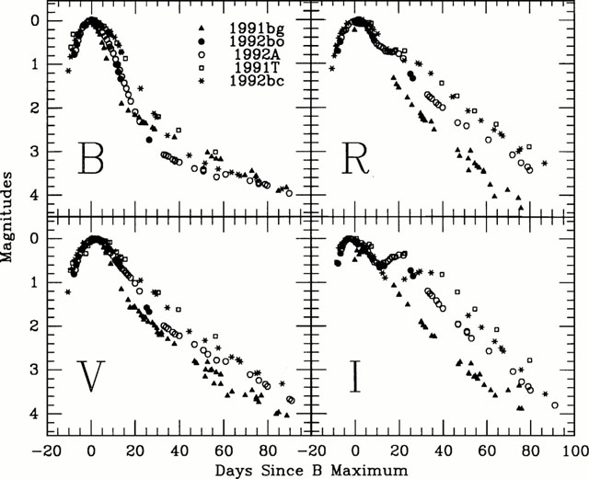
SN Ia light curves
Suntzeff (1996)

Slide 16
Type Ia Supernovae
Not collapse of core of a massive star (types Ib/Ic/II)
Degenerate white dwarf matter is subject to runaway nuclear burning of ¹²C + ¹²C; reactions continue to ²⁸Si … ⁵⁶Ni
Energy yield of fusion sufficient to unbind the star.
White dwarf is destroyed
“Light” seen comes from ⁵⁶Ni → ⁵⁶Co → ⁵⁶Fe decay chain
Gamma rays are absorbed and thermalized in expanding debris.
Kinetic energy seen only in interaction with ISM (much later)
Major source of Fe-peak elements
But we still don’t know the ignition source.
“Single degnerate” (1 white dwarf accreting from normal companion) vs. “double degenerate” (merger or collision of 2 white dwarfs)

Slide 17
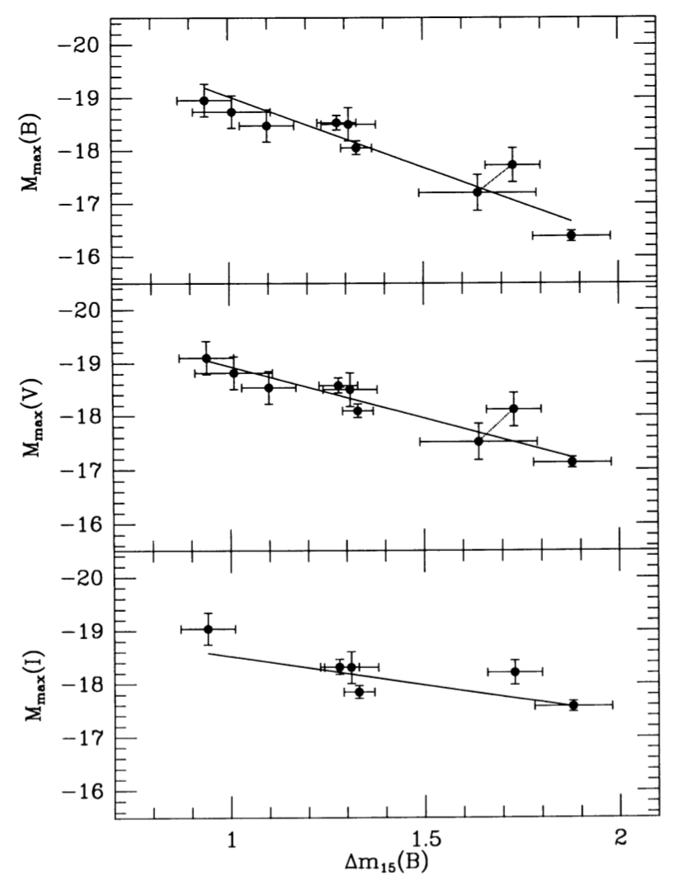
Luminosity-Decay Rate Relation
Phillips (1993)
Maximum absolute magnitude vs. Δm₁₅(B) (number of magnitudes of fading in B band in 15 days from peak)
Not in the same galaxy (too rare!). Distances estimated from galaxy scaling relations
“Modern” analyses calibrate directly from Cepheids to SNe Ia without galaxy scaling relations as an intermediate step.

Slide 18
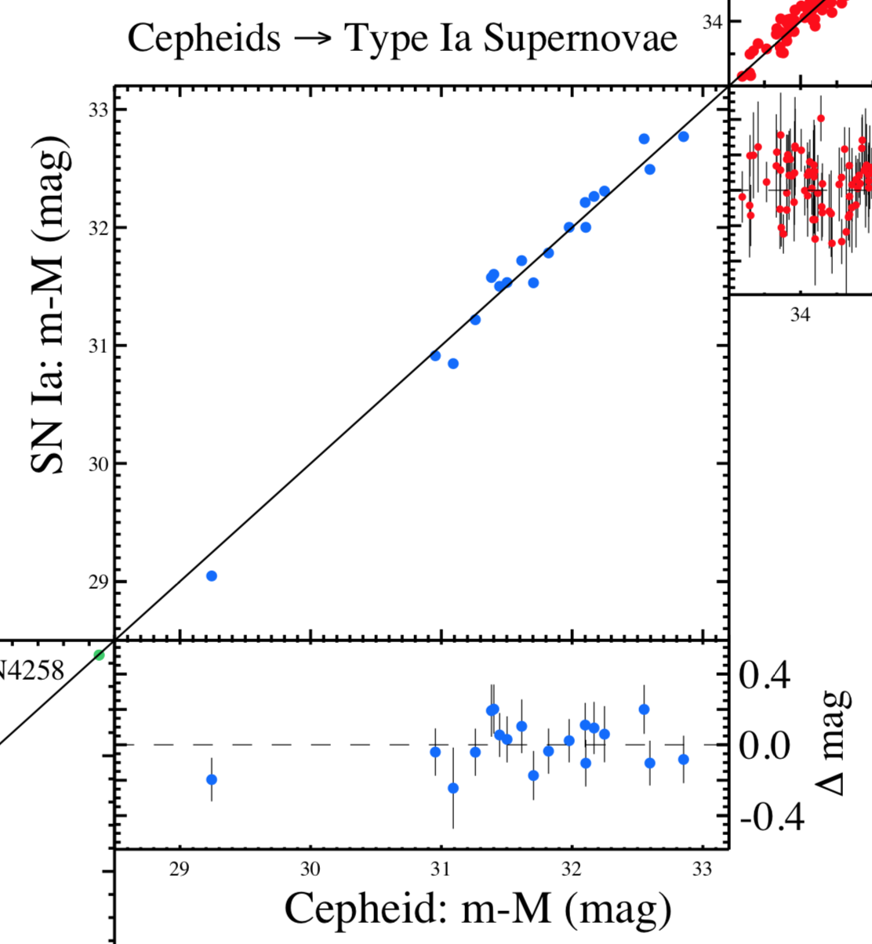
Cepheids vs. SNe Ia
19 galaxies hosting both a Type Ia supernova and Cepheids measured with HST
Slope is indeed 1
M101
Riess et al. (2016)

Slide 19
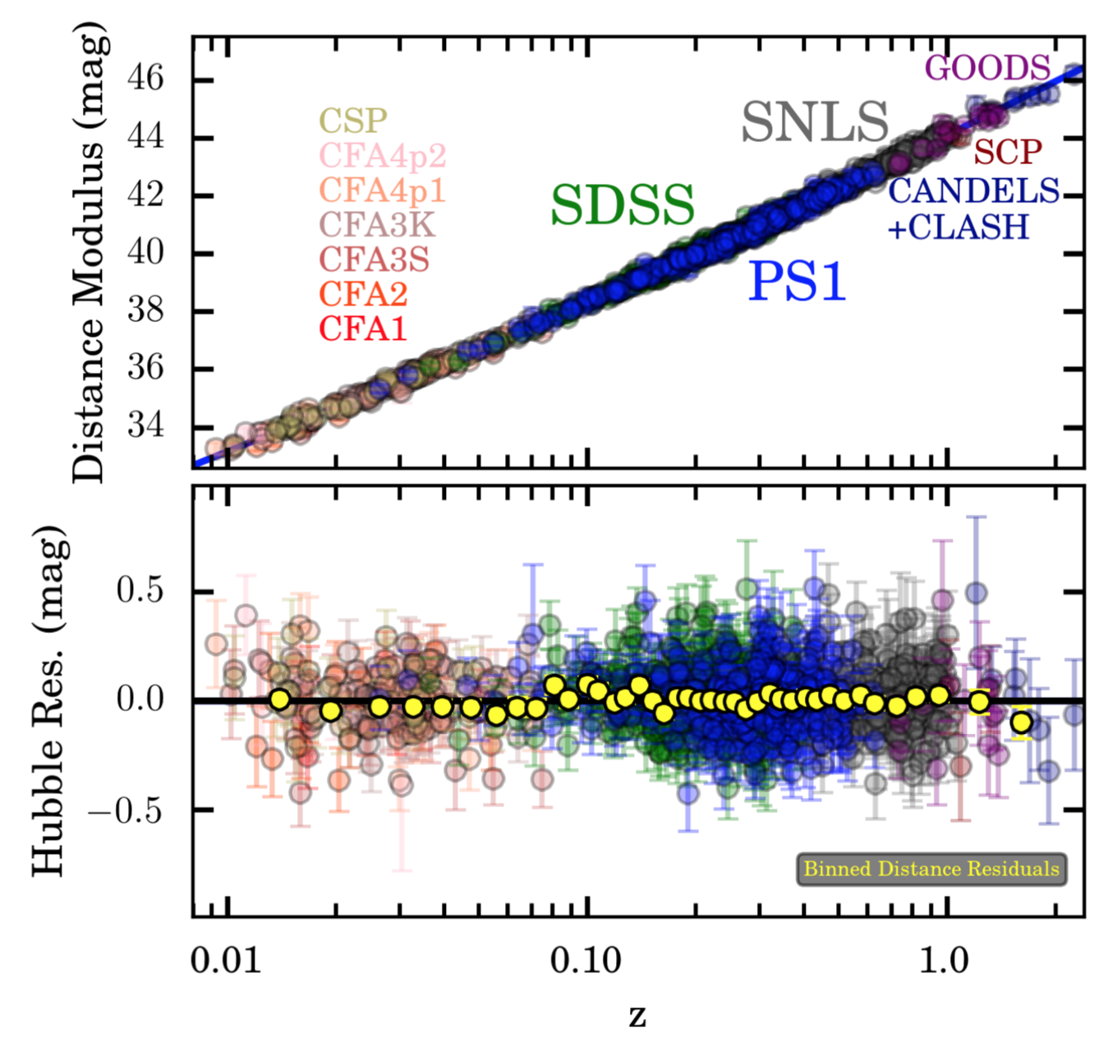
Type Ia SNe to higher z!
Pantheon Sample
1000 supernovae (compiled from many projects)
Scolnic et al. (2018)
A few objects out to z~2

Slide 20
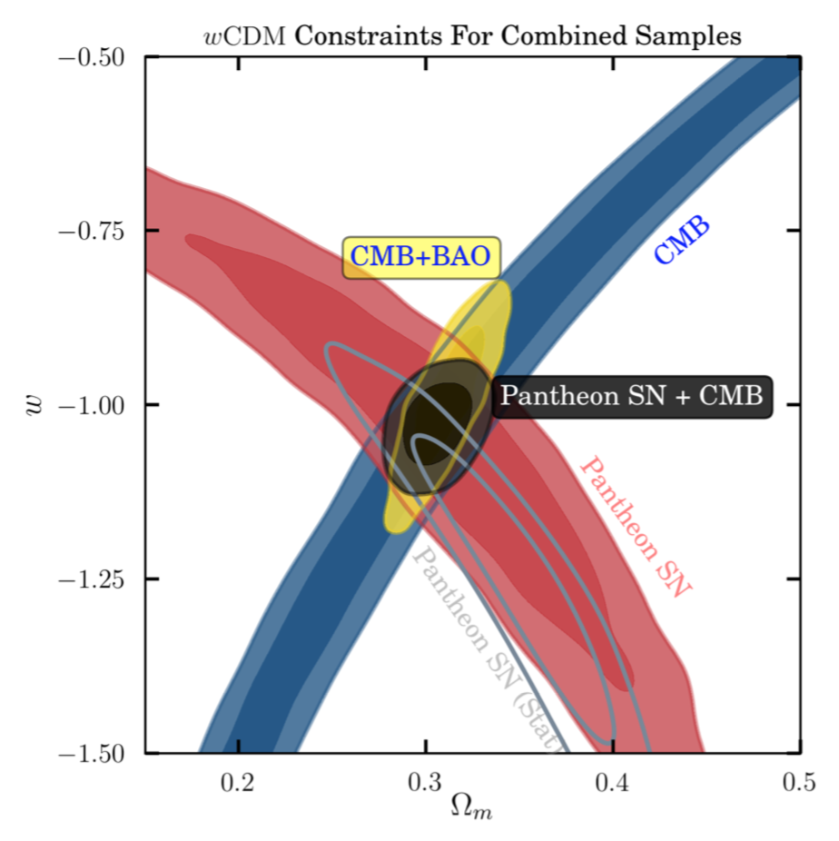
Constraints on Dark Energy
Hubble diagram
turns down
Note – constraints on Ω_{m} and w can be obtained with a relative distance indicator.
“Anchor” only appears if you want to know H₀ …
Hubble diagram
turns up
Scolnic et al. (2018)

Slide 21
Issues with SNe Ia?
SNe Ia have proven to be the best luminosity standard thus far that can be measured at cosmological distances, but there are some systematic errors.
Evolution (supernova populations vs. time)
Selection biases (missing intrinsically faint supernovae at high z)
Modeling of Philips relation parameters
Calibration (bright vs. faint, across instruments, and wavelengths!)
Dust extinction …

Slide 22
Distance “Anchors”
Historically, wanted to know H₀
Can only do this with an absolute distance measurement that calibrates the Cepheid distance scale.
Usually based on fortuitous circumstances that allow measurement of distance to one object.

Slide 23
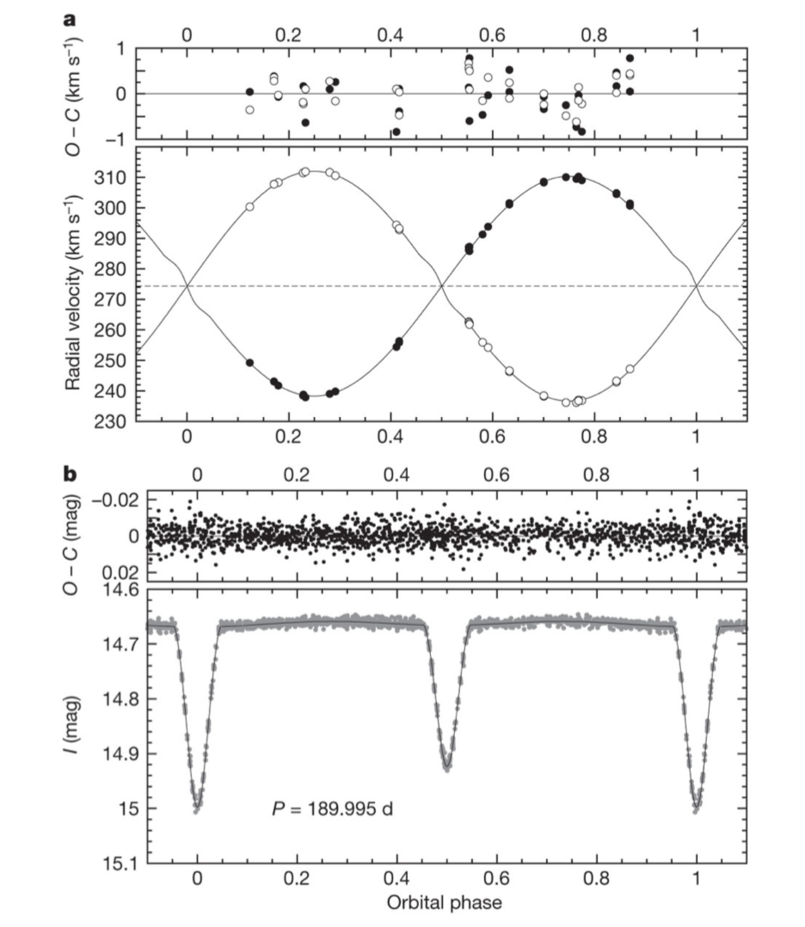
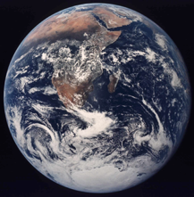
Eclipsing Binaries in LMC
Radial velocities
observable spectroscopically
Eclipse duration observable photometrically
to Earth
Pietrzyński et al. (2013)
D(LMC) = 49.97 ± 0.19 ± 1.11 kpc

Slide 24
Distance Ladder in Hubble Key Project
Tully-Fisher relation
H₀ = 71±3±7 km/s/Mpc
Fundamental Plane
H₀ = 82±6±9 km/s/Mpc
(anchor)
Large Magellanic Cloud – compilation of 7 methods
(50.1 ± 2.3 kpc)
Cepheid
Period-Luminosity relation
Surface brightness fluctuations
H₀ = 70±5±6 km/s/Mpc
Type Ia supernovae
H₀ = 71±2±6 km/s/Mpc
Combined result:
H₀ = 72±8 km/s/Mpc
(Freedman et al. 2001)
Type II supernovae
H₀ = 72±9±7 km/s/Mpc

Slide 25
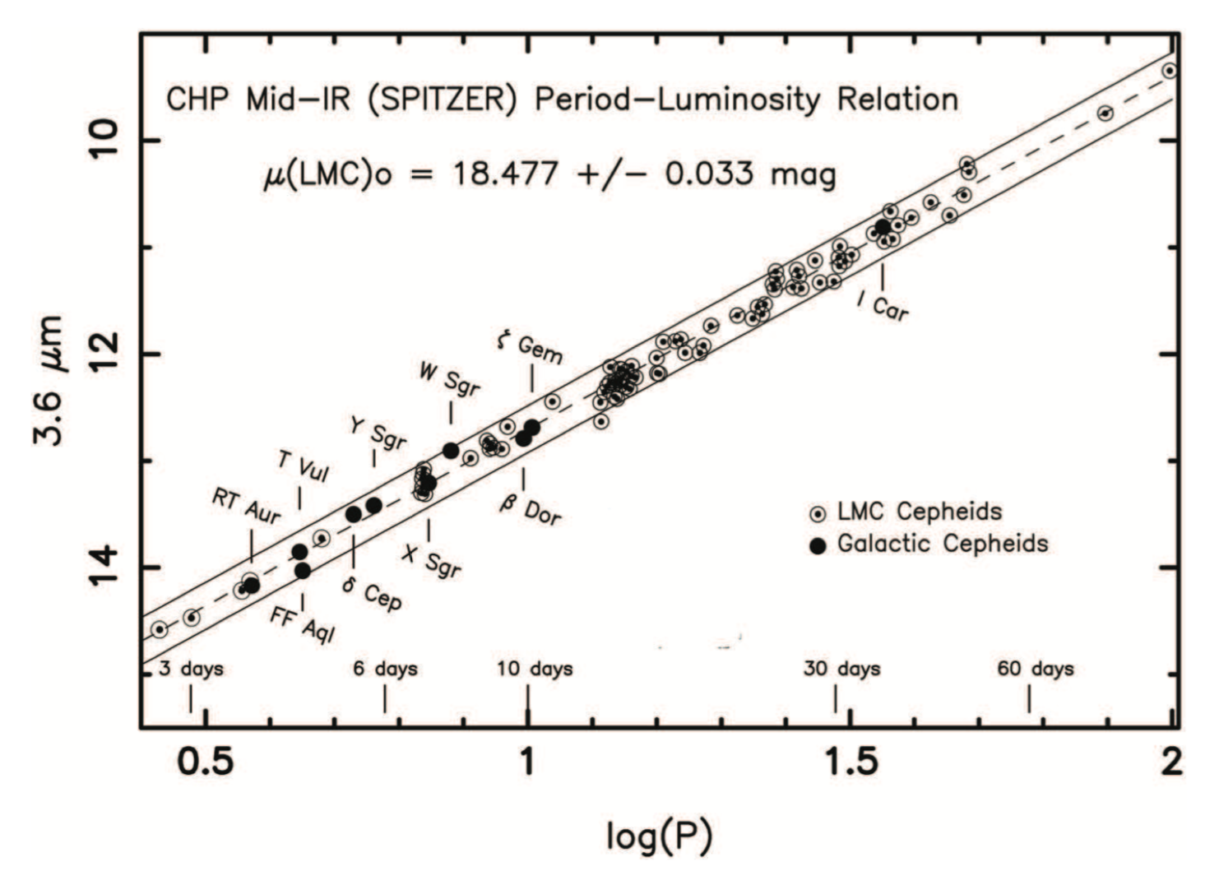
Infrared Leavitt Law
Dust & metallicity effects are lower in the infrared
Slope of P-L relation driven by LMC, but intercept (absolute scale) set by Milky Way Cepheids with HST parallax
In combination with other improvements to the Key Project:
H₀ = 74.3±2.1 km/s/Mpc
Freedman et al. (2012)

Slide 26
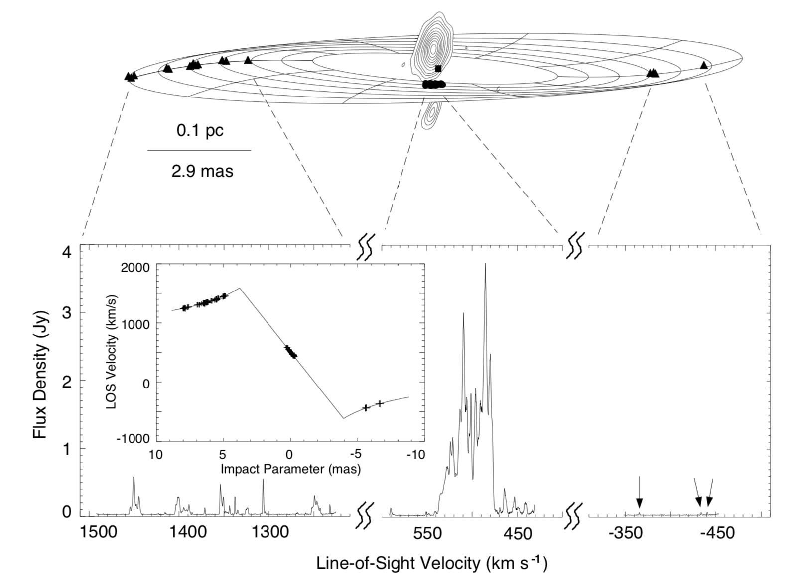
H₂O 22 GHz Maser System in NGC 4258 (spatially resolved via VLBI)
Herrnstein et al. (1999)

Slide 27
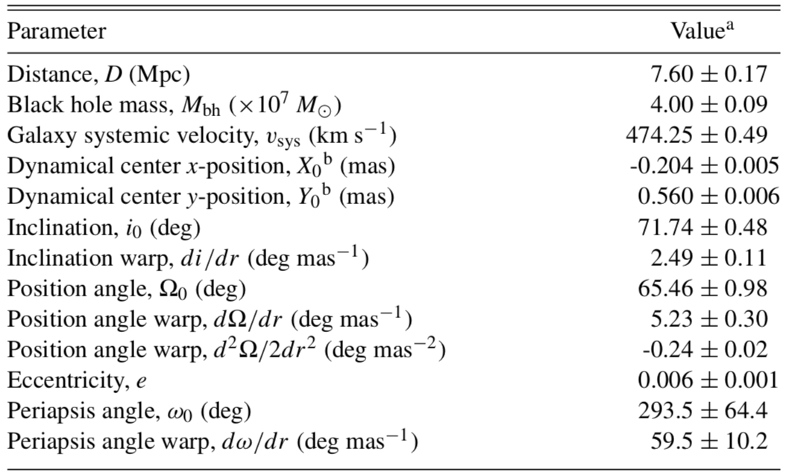
Fitting the maser system …
Left & right
Center
Humphreys et al. (2013)

Slide 28
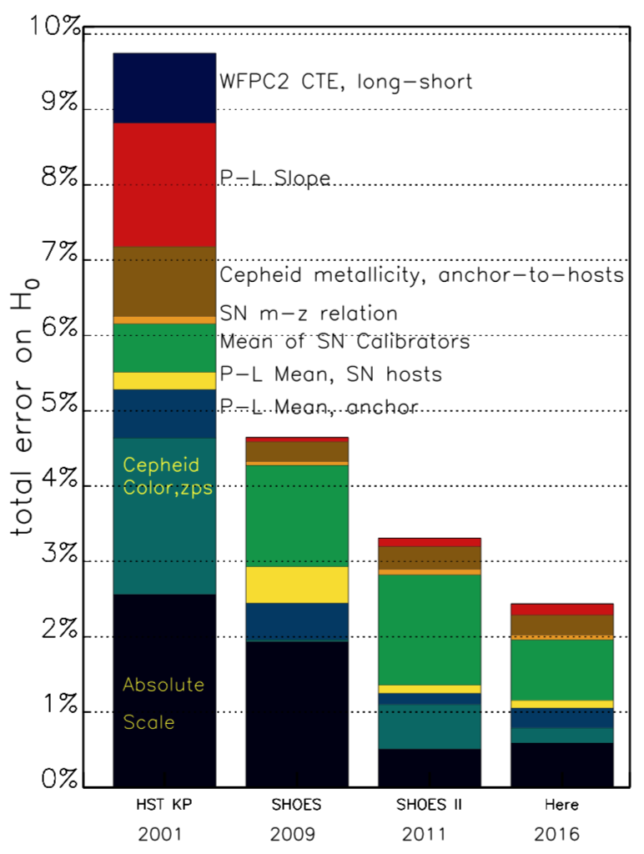
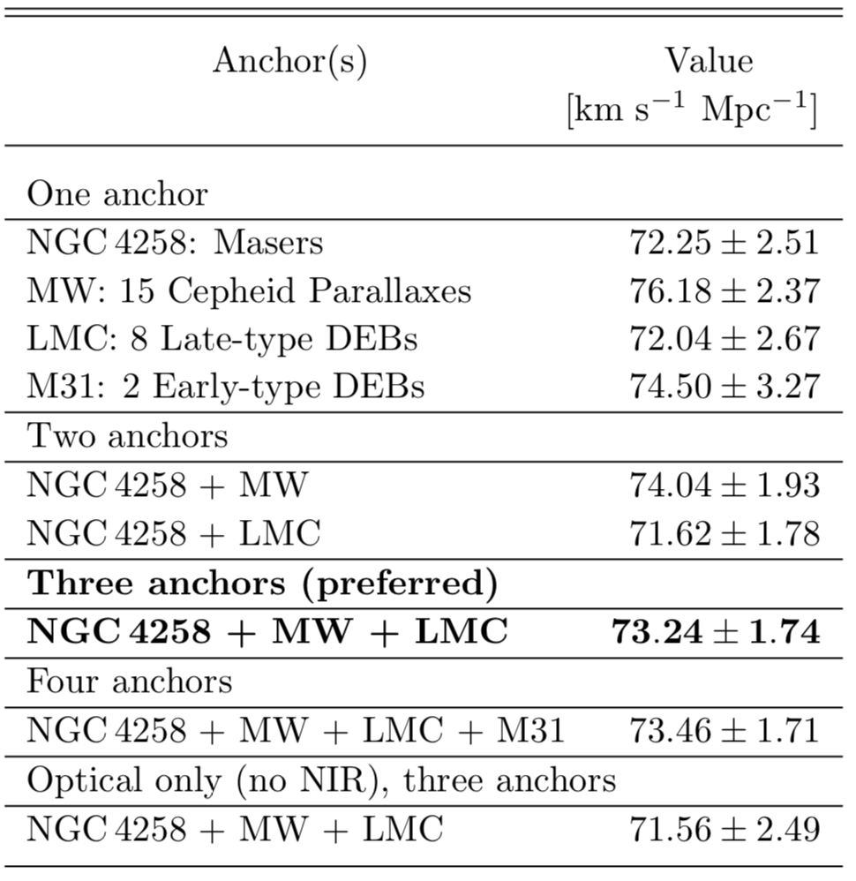
Updated Direct H₀ Measurement (Riess et al. 2016)
… but prediction from running CMB (Planck) model forward:
66.93 ± 0.62 km/s/Mpc
Why the discrepancy?

Slide 29
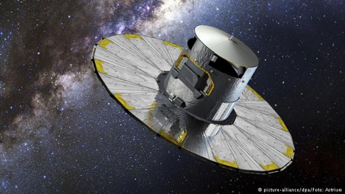
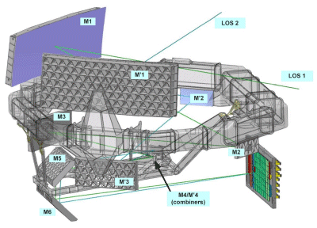
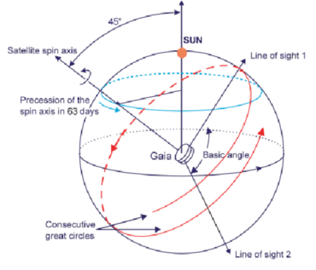
The Gaia Mission
Trigonometric parallax reinvigorated by launch of European Space Agency Gaia astrometric mission in 2013

Slide 30
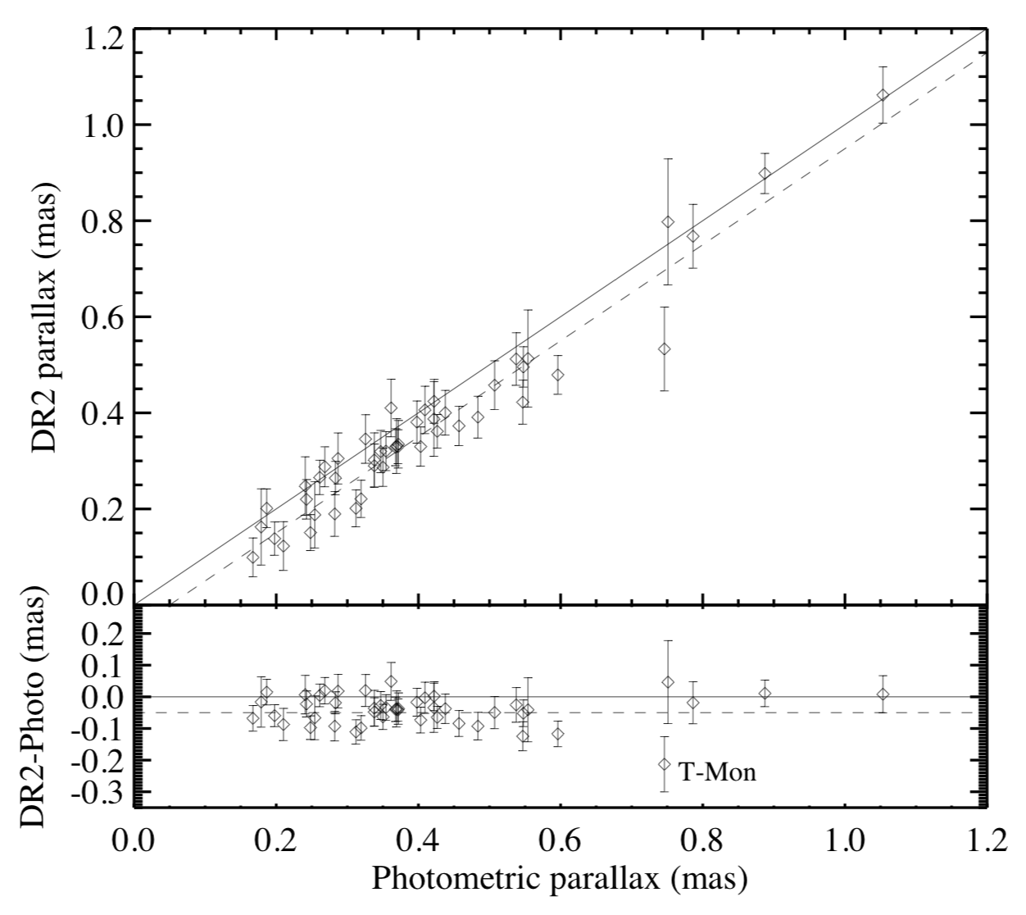
MW Cepheid Parallaxes from Gaia
Riess et al. (2018)
Use Gaia Data Release 2 (DR2) as check on prior Cepheid distance scale
Scaling factor of 1.006±0.033 from maser + eclipsing binary distance scale
–46±13 µas intercept spurred some controversy

Slide 31
Gravitational Wave Sources (proposed by Schutz 1986)
GW strain in units of 10⁻²³ (angle averaged):
Inspiral timescale in seconds:
Therefore:
→ Distance indicator based on “clean” physics!!
Binary system:
Masses m₁, m₂ (in M_{Sun})
GW frequency f = 100f₁₀₀ Hz
(2x orbital frequency)
Distance r = 100r₁₀₀ Mpc

Slide 32
What’s Needed?
Must identify host galaxy to tie this to other distance scales – r is the distance to what?
“Electromagnetic counterpart” problem
“Angle averaged” → today, we talk about distance-inclination degeneracy
… and …
(as written in 1986!)

Slide 33
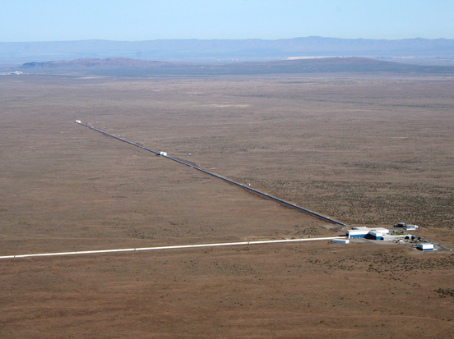
LIGO – Hanford Site (1 of 2)
Caltech / MIT / LIGO Lab

Slide 34
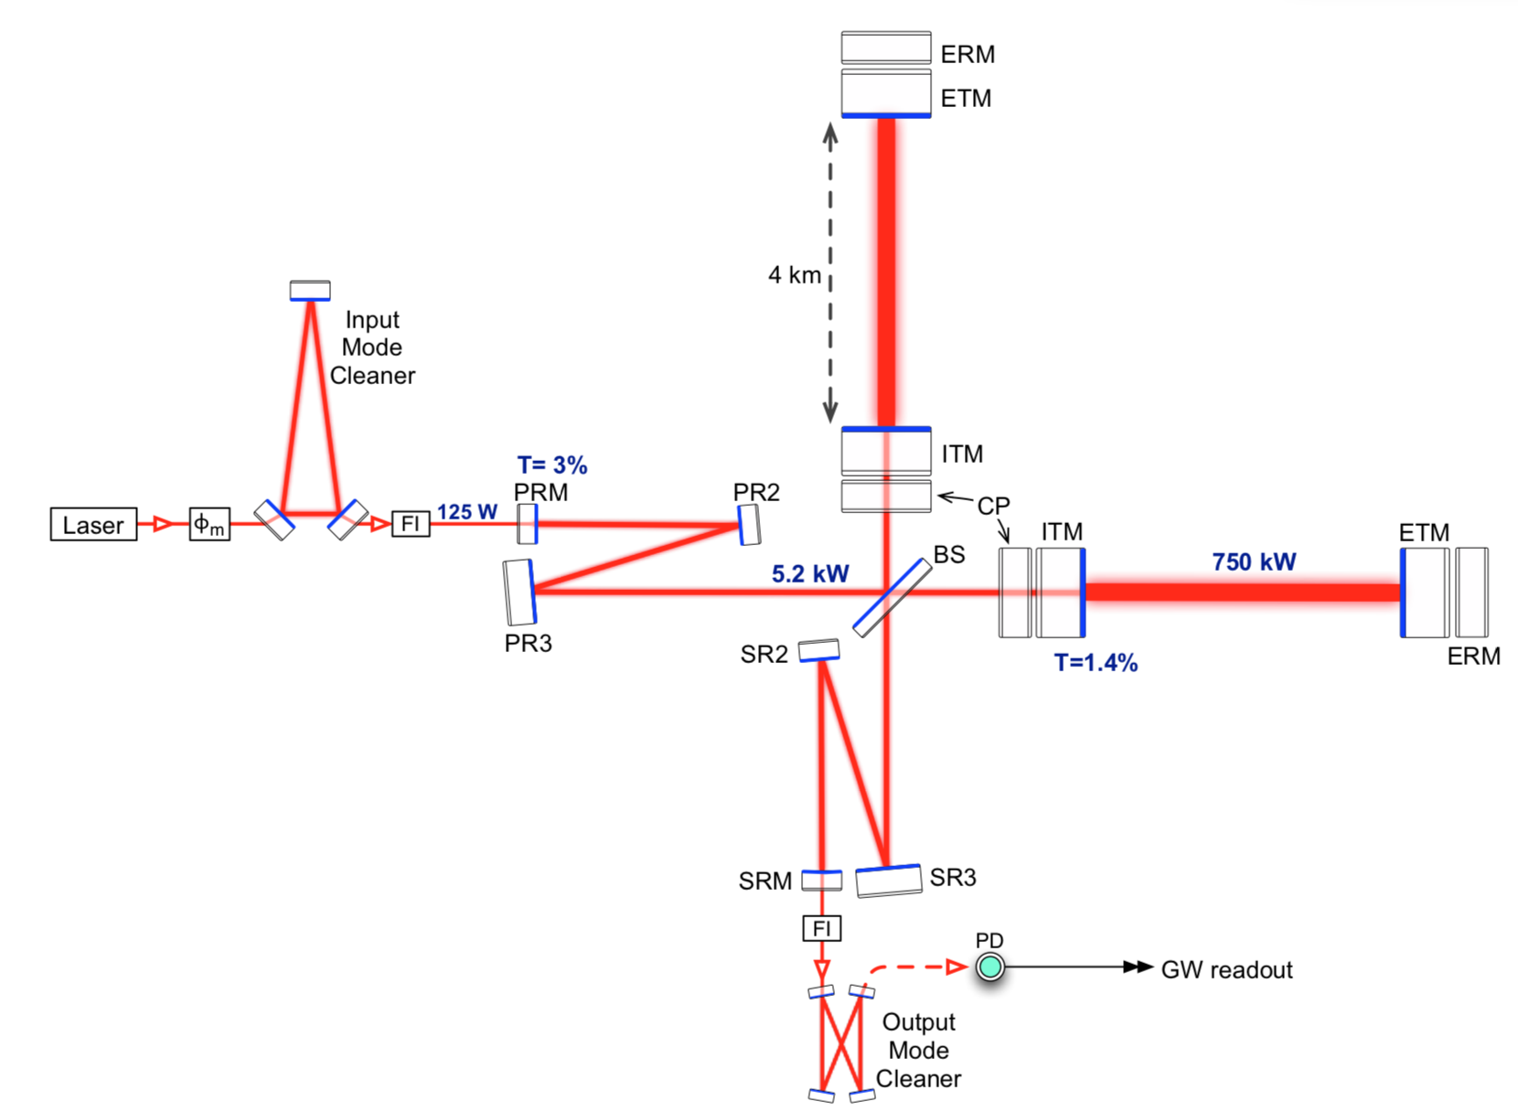
Advanced LIGO
Optical Layout of the Interferometer
[Fabry-Perot Cavity]
LIGO Scientific Collaboration (2014)

Slide 35
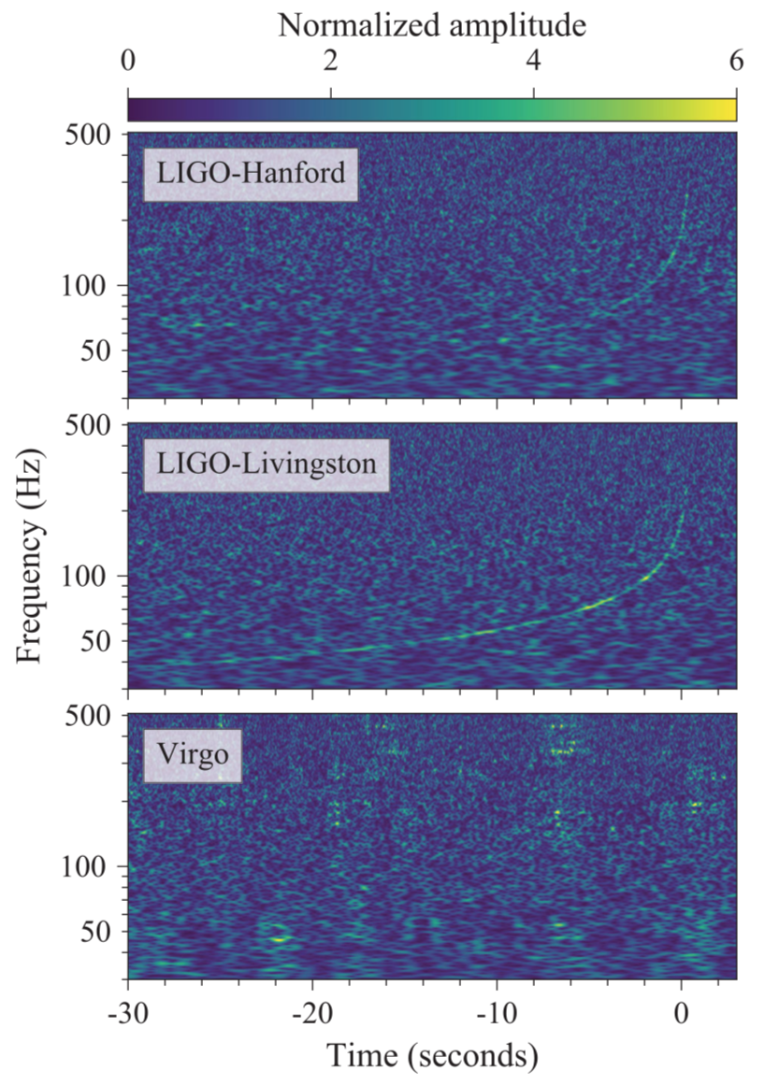
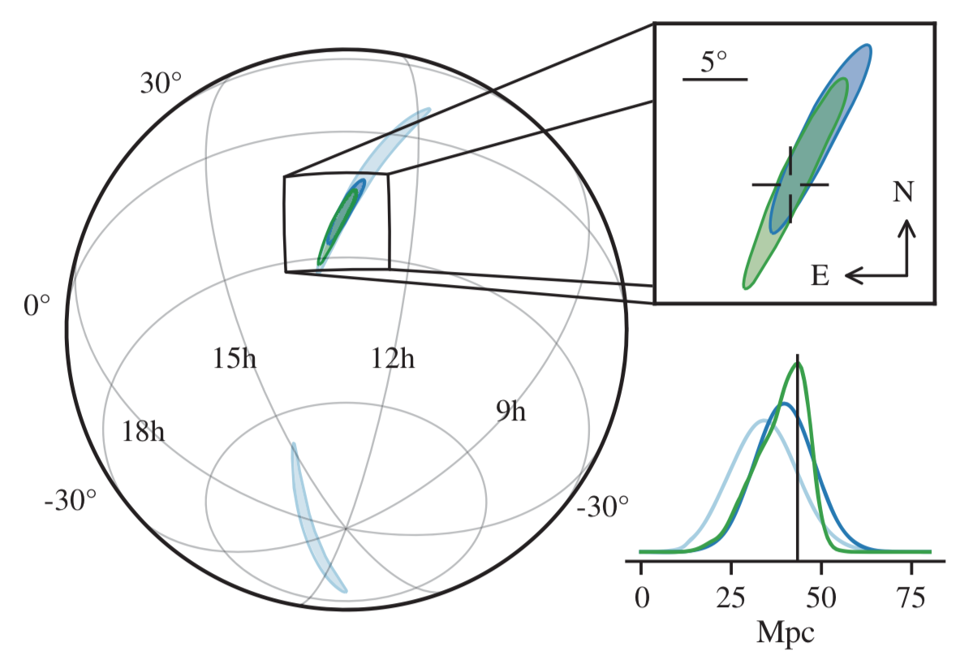
GW 170817 (LIGO + Virgo Collaborations 2017)
Sky localization

Slide 36
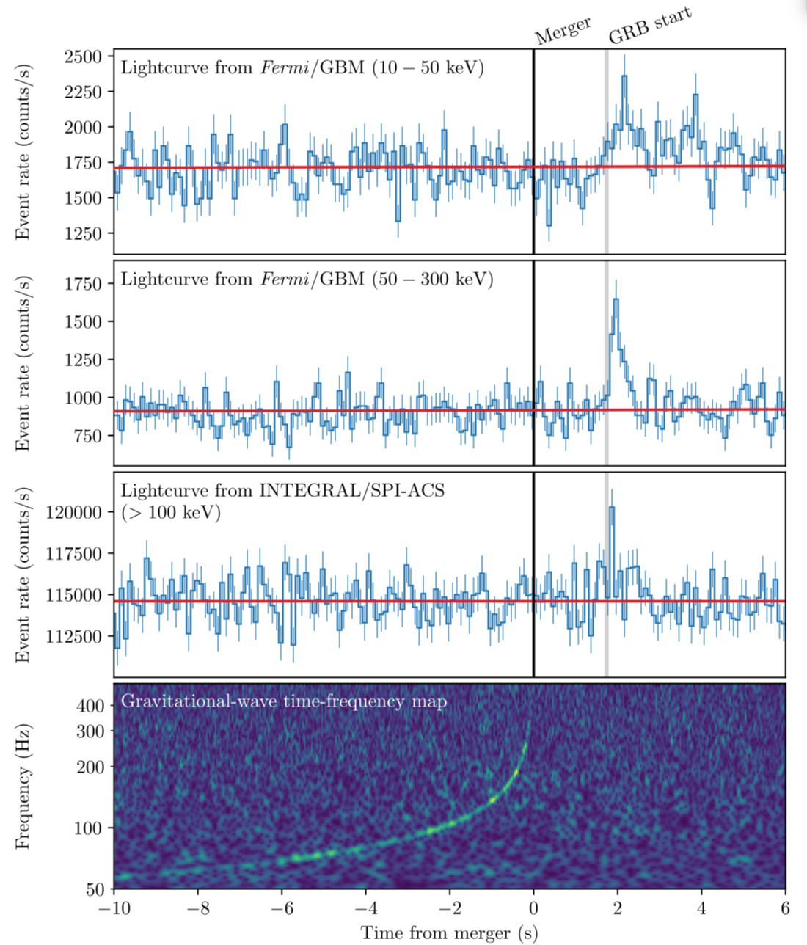
Gamma Ray Burst
Coincident with GW Event
(LIGO, Virgo, Fermi-GBM, INTEGRAL Collaborations, 2017)

Slide 37
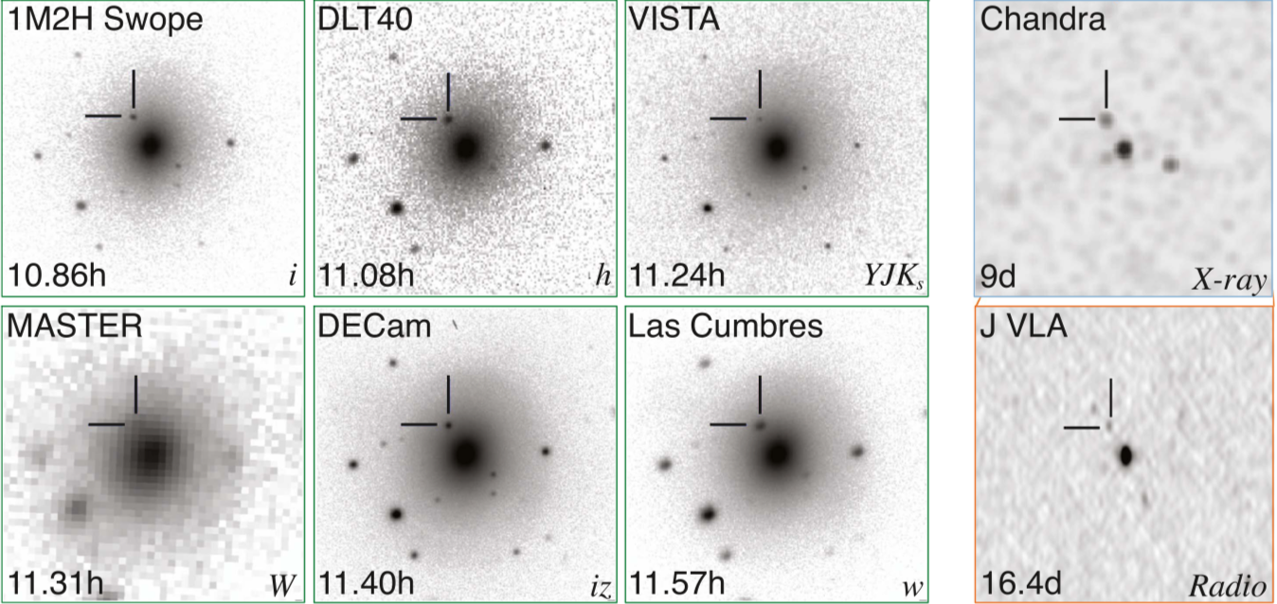
Multi-Wavelength Electromagnetic Observations of GW170817 (Many Collaborations, 2017)
Host galaxy is NGC 4993, z = 0.0097

Slide 38
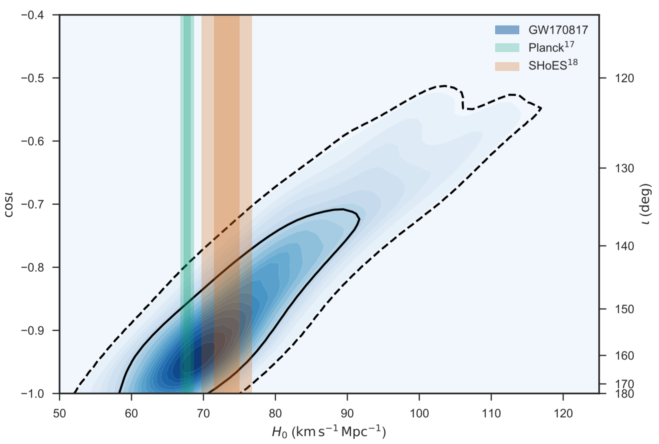
H₀ from 1 Gravitational Wave Source
Direct measurement
from Cepheids + SN Ia
Prediction from CMB + ΛCDM
Distance – inclination degeneracy

Slide 39
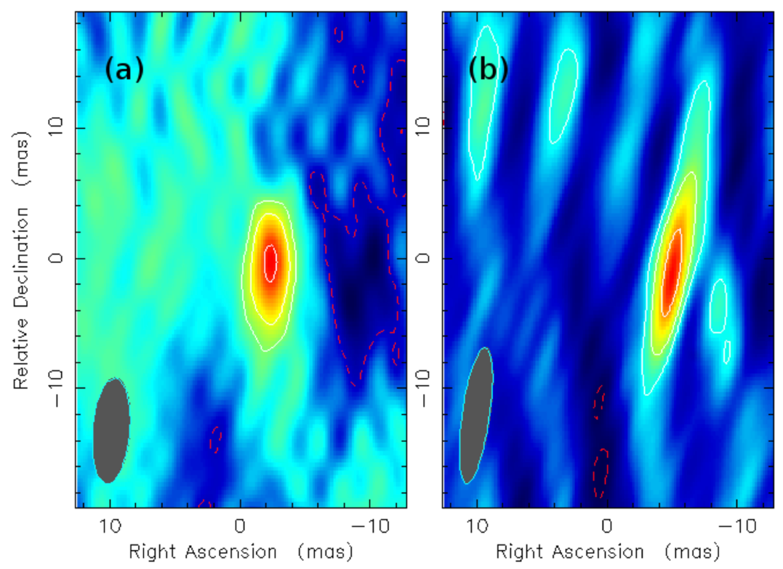
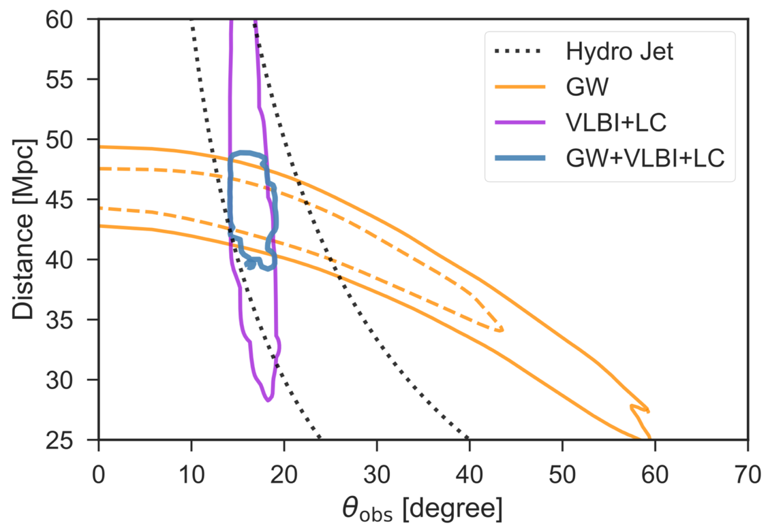
Proper Motion of the Jet by VLBI (Mooley et al. 2018; Kotokezaka et al. 2018)
The jet tracked at 4.5 GHz
From 75 to 230 days:
2.67±0.19±0.21 mas East (with 1 source; more to come?)
0.2±0.6±0.7 mas North
Apparent v/c = 4.1±0.5 (artifact of light-travel time; “real” v/c is ≈1)

Slide 40
Extragalactic Distance Scale – Summary
Lots of history, many methods
But modern developments are coming from many wavebands and techniques
Gamma rays through radio, as well as non-electromagnetic messengers
Lots of clever physics ideas
But precision is key!
Big outstanding issue today is conflict between direct H₀ measurement and prediction from CMB
Much more to come!

